Slide 1
Software Design
Lecture 1
Babak Khazaei

Slide 2
Lecture content
The Assignment For THE COLLABORATIVE DESIGN: See Assignment
Blaise Pascal once wrote, "I am writing you a long letter, because I haven't got time to write you a short one." There is thus a maximum time limit for the total STAND ALONE presentation of 15 minutes, which will be strictly adhered to.
Lab/Tutorial 1
Collaborative Design
Examine different types of decomposition
Software Eng. 4th Edition Pfleeger & Atlee chapter 5

Slide 3
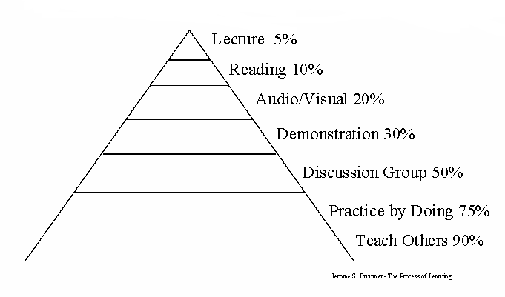
Teaching and Learning
Pyramid Learning (average retention rates)

Slide 4
Collaborative Design
Usually the design of software systems is performed by a team of developers
Several issues must be addressed by the team:
Who is best suited to design each aspect of the system
How to document all aspects
How to coordinate and integrate the software units
Important to view group interaction in its cultural and ethical contexts

Slide 5
5.1 The Design Process
Design is the creative process of figuring out how to implement all of the customer’s requirements; the resulting plan is also called the design
Early design decisions address the system’s architecture
Later design decisions address how to implement the individual units

Slide 6
5.1 The Design Process Design is a Creative Process
Design is an intellectually challenging task
Numerous possibilities the system must accommodate
Nonfunctional design goals (e.g., ease of use, ease to maintain)
External factors (e.g., standard data formats, government regulations)
We can improve our design by studying examples of good design (see lecture on Design Patterns)
Most design work is routine design, solve problem by reusing and adapting solutions from similar problems

Slide 7
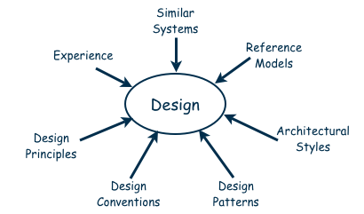
5.1 The Design Process Design is a Creative Process (continued)
Many ways to leverage existing solutions
Cloning: Borrow design/code in its entirety, with minor adjustments
Reference models: Generic architecture that suggests how to decompose the system

Slide 8
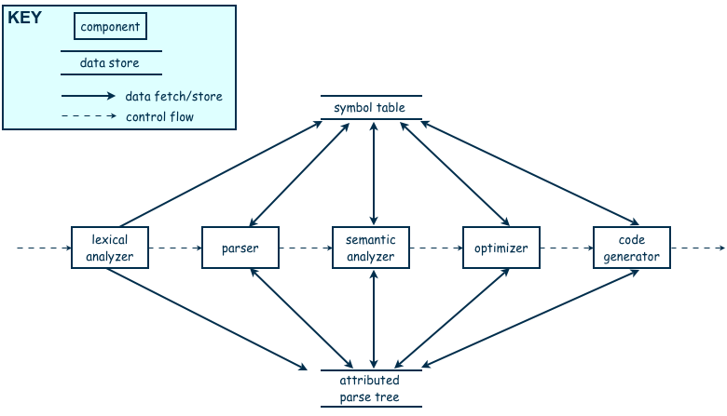
5.1 The Design Process Design is a Creative Process (continued)
Reference model for a compiler

Slide 9
5.1 The Design Process Design is a Creative Process (continued)
More typically, a reference model will not exist for the problem
Software architectures have generic solutions too, referred to as architectural styles
Focusing on one architectural style can create problems
Good design is about selecting, adapting, and integrating several architectural design styles to produce the desired result

Slide 10
5.1 The Design Process Design is a Creative Process (continued)
Many tools for understanding options and evaluating chosen architecture, including:
Design patterns: generic solutions for making lower-level design decisions
Design convention or idiom: collection of design decisions and advice that, taken together, promotes certain design qualities
Innovative design: characterized by irregular bursts of progress that occur as we have flashes of insight
Design principles: descriptive characteristics of good design

Slide 11
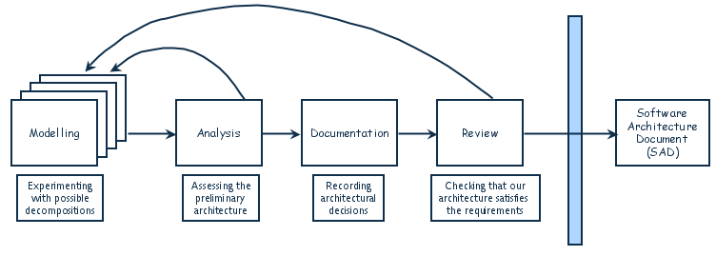
5.1 The Design Process Design Process Model
Designing software system is an iterative process
The final outcome is the software architecture document (SAD)

Slide 12
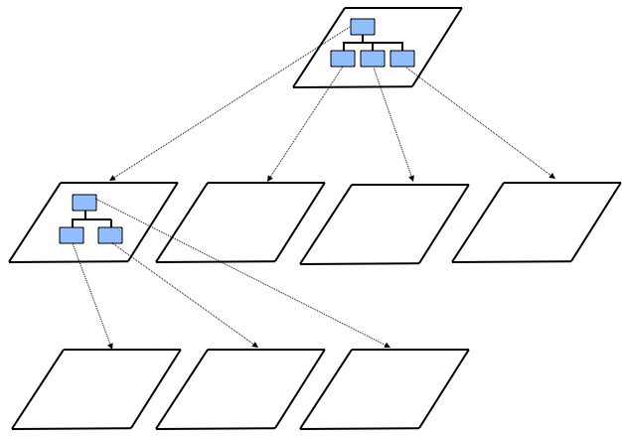
5.3 Decomposition and Views
High-level description of system’s key elements
Creating a hierarchy of information with increasing details
Top
level
First level of
decomposition
Second level of
decomposition

Slide 13
5.3 Decomposition and Views Popular Design Methods
Some design problems have no existing solutions
Designers must decompose to isolate key problems
Some popular design methods:
Functional decomposition
Feature-oriented decomposition
Data-oriented decomposition
Process-oriented decomposition
Event-oriented decomposition
Object-oriented decomposition

Slide 14
5.3 Decomposition and Views Popular Design Methods
Functional decomposition
partitions functions or requirements into modules
begins with the functions that are listed in the requirements specification
lower-level designs divide these functions into subfunctions, which are then assigned to smaller modules
describes which modules (subfunctions) call each other

Slide 15
5.3 Decomposition and Views Popular Design Methods
Feature-oriented decomposition
assigns features to modules
high-level design describes the system in terms of a service and a collection of features
lower-level designs describe how each feature augments the service and identifies interactions among features

Slide 16
5.3 Decomposition and Views Popular Design Methods
Data-oriented decomposition
focuses on how data will be partitioned into modules
high-level design describes conceptual data structures
lower-level designs provide detail as to how
data are distributed among modules
distributed data realize the conceptual models

Slide 17
5.3 Decomposition and Views Popular Design Methods
Process-oriented decomposition
partitions the system into concurrent processes
high-level design:
identifies the system’s main tasks
assigns tasks to runtime processes
explains how the tasks coordinate with each other
Lower-level designs describe the processes in more detail

Slide 18
5.3 Decomposition and Views Popular Design Methods
Event-oriented decomposition
focuses on the events that the system must handle and assigns responsibility for events to different modules
high-level design catalogues the system’s expected input events
lower-level designs decompose the system into states and describe how events trigger state transformations

Slide 19
5.3 Decomposition and Views Popular Design Methods
Object-oriented decomposition
assigns objects to modules
high-level design identifies the system’s object types and explains how objects are related to one another
lower-level designs detail the objects’ attributes and operations

Slide 20
5.3 Decomposition and Views
A design is modular when each activity of the system is performed by exactly one software unit, and when the inputs and outputs of each software unit are well-defined
A software unit is well-defined if its interface accurately and precisely specifies the unit’s externally visible behavior

Slide 21
5.3 Decomposition and Views Sidebar 5.2 Component-based Software Engineering
Component-based software engineering (CBSE) is a method of software development whereby systems are created by assembling together preexisting components
A component is “a self-contained piece of software with a well-defined set of interfaces” that can be developed, bought, and sold as a distinct entity
The goal of CBSE is to support the rapid development of new systems, by reducing development to component integration, and to ease the maintenance of such systems by reducing maintenance to component replacement
At this point, CBSE is still more of a goal than a reality with considerable on-going research

Slide 22
5.3 Decomposition and Views Architectural Views
Common types of architectural views include:
Decomposition view
Dependencies view
Generalization view
Execution view
Implementation view
Deployment view
Work-assignment view

Slide 23
5.3 Decomposition and Views Decomposition View
The decomposition view portrays the system as programmable units
This view is likely to be hierarchical
May be represented by multiple models

Slide 24
5.3 Decomposition and Views Dependencies View
The dependencies view shows dependencies among software units
This view is useful in project planning
Also useful for assessing the impact of making a design change to some software unit

Slide 25
5.3 Decomposition and Views Generalization View
The generalization view shows software units that are generalizations or specializations of one another
This view is useful when designing abstract or extendible software units

Slide 26
5.3 Decomposition and Views Execution View
The execution view is the traditional box-and-arrow diagram that software architects draw, showing the runtime structure of a system in terms of its components and connectors
Each component is a distinct executing entity, possibly with its own program stack
A connector is some intercomponent communication mechanism, such as a communication channel, shared data repository, or remote procedure call

Slide 27
5.3 Decomposition and Views Implementation View
The implementation view maps code units to the source file that contains their implementation
Helps programmers find the implementation of a software unit within a maze of source-code files

Slide 28
5.3 Decomposition and Views Deployment View
The deployment view maps runtime entities, such as components and connectors, onto computer resources, such as processors, data stores, and communication networks
It helps the architect analyze the quality attributes of a design, such as performance, reliability, and security

Slide 29
5.3 Decomposition and Views Work-assignment View
The work-assignment view decomposes the system’s design into work tasks that can be assigned to project teams
Helps project managers plan and allocate project resources, as well as track each team’s progress

Slide 30
Summary Lecture 1
Different aspects of software design
Decomposition and views of design

